Slide 1
Retail Customers insights
Team: Yuval Noah Harari
Devi Somalinga Bhuvanesh
Gurrup Kaur Gurbir Singh Soi
Vy Hoang Mai Duong
Notes:
Vy: 1-5 & 13-14 : 2min + 1min
Gurrup: 15-end: 3 min
Devi: 6-12 : 3 min

Slide 2
Table of CONTENTS
1. Yuval Noah Harari – Life and Achievements
2. Retail Customers Insights
Data Preparation & Categorization
Target Audiences & Department Dashboards
3. Conclusions & Recommendations

Slide 3



Yuval Noah Harari (born 1976)
Notes:
Vy will add

Slide 4
Yuval Noah Harari
Who he is
He’s known for:
An Israeli public intellectual and historian.
PhD from the University of Oxford in 2002
Professor in the Department of History at the Hebrew University of Jerusalem.
International best-selling authors of:
Sapiens: A Brief History of Humankind (2014)
Homo Deus: A Brief History of Tomorrow (2016)
21 Lessons for the 21st Century (2018).
Sapiens: A Graphic History
Unstoppable Us
Keynote speaker about social, historic and global topics.

Slide 5
Yuval Noah Harari
achievements
His books have sold 40 Million copies in 65 languages
He had publicly met and discussed with various heads of state (Prime Ministers, Chancellors, Presidents) and global top businessmen
He travels the world to share on the topics explored in his books
Co-Founded the Sapienship community (https://www.ynharari.com/sapienship/) to share about world challenges
“History began when humans invented gods – and will end when humans become gods.”

Slide 6
Retail customers insights

Slide 7
Data preparation & categorization
Notes:
Include the EDA that Proff conmments here

Slide 8
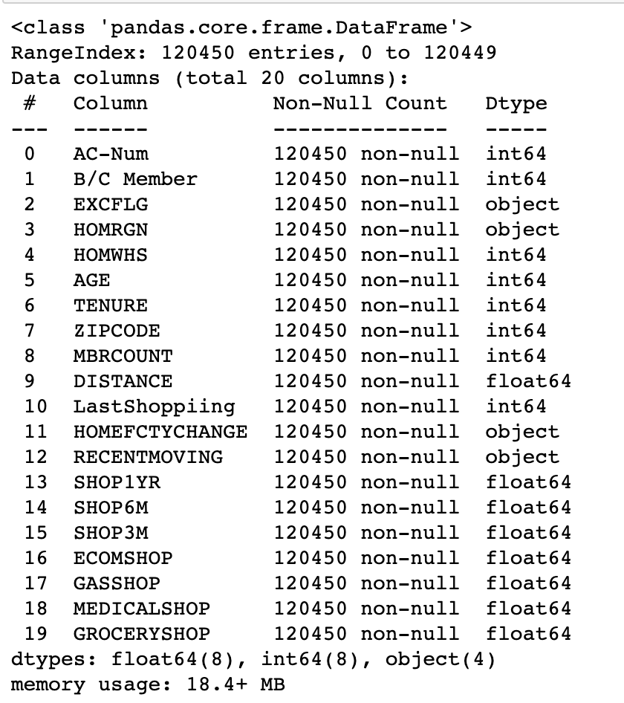
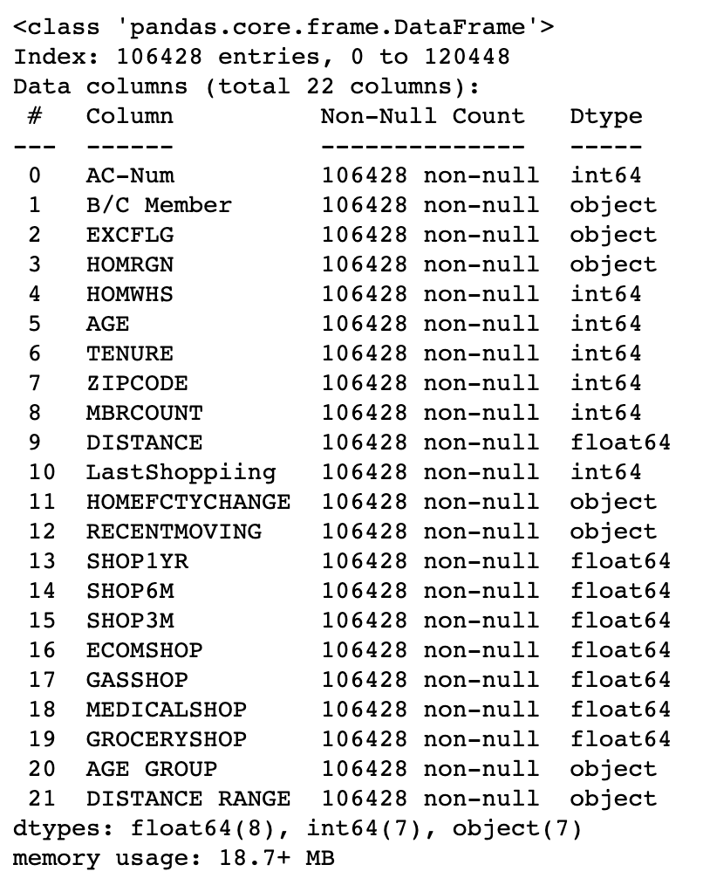
Data preparation
Removal of Duplicate Values
RAW DAtabase
Final DAtabase
A total of 14,022 duplicate rows were identified and removed.
Replacing Category Value Names
"B/C Member" column's values, 1 and 2 were replaced with the corresponding categories "Consumer" and "Business"
"EXCFLG" column's values, E and N, representing Executive and Non-Executive were replaced.
Addition of New Columns
Two new columns were created:
Age Group
Distance Range

Slide 9
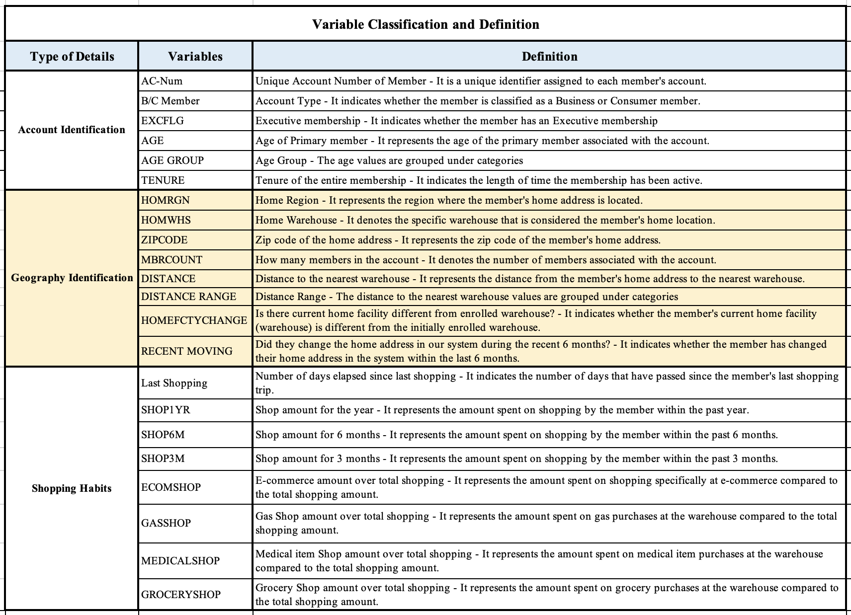
Data Categorization
Divide into 3 sub-categories
Account identification
Geography identification
Shopping habits

Slide 10
01 Store development
02 membership
03 marketing
Store locations and the impact of distance on Shopping habits
Target audience
&
Department
dashboards
Focus on Membership in regard of Sales, Frequency & Locations
Customer demographics and spending patterns
Notes:
Devi: store development
Gurrup: Marketing
Vy: membership
We can shortly show the dept dashboard here. And go deeply into the 2 question in following up slides

Slide 11
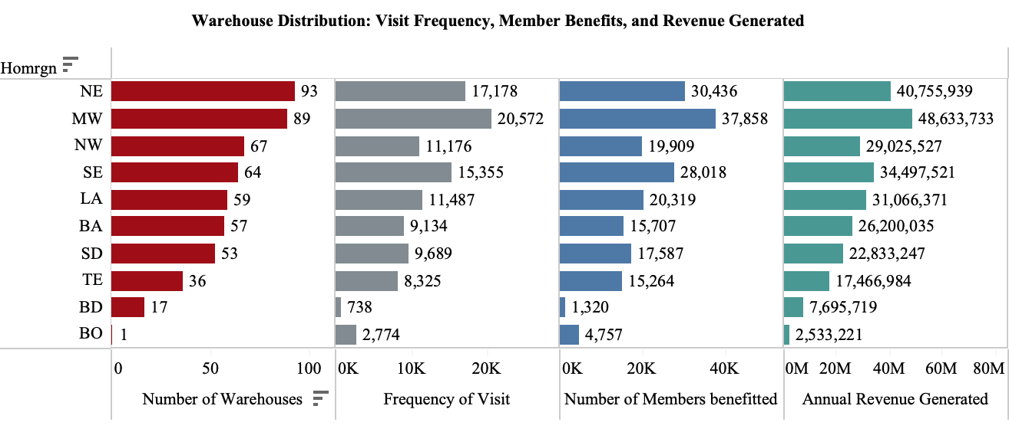
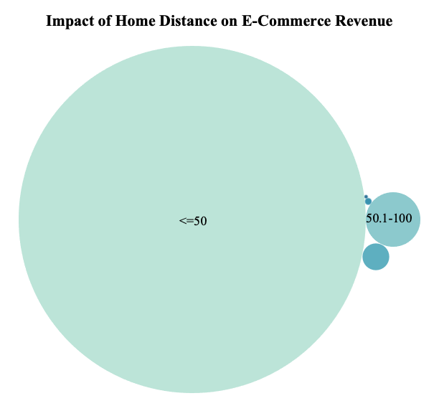
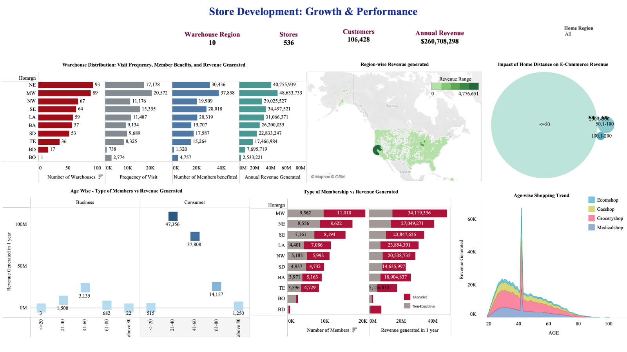
Store development team
46% of the customers belong to 21-40 years followed by 41-60 years old with 38%
Notes:
Bar chart -
Despite the Northeast (NE) region having the highest number of warehouses, it is the Midwest (MW) region that stands out with a remarkable visit frequency of 20,572, resulting in significant member benefits for 37,858 individuals and generating the highest revenue.
Surprisingly, even though there is only one warehouse in the BO region, it attracts a notable number of visitors and benefits from member engagement
With further analysis of population requirements, the retail store can consider opening new warehouses in the BO region catering the needs of more people and generating more revenue.
Also, by analyznig the region-wise gaps in each store, the store develoment team with the help of marketing and membership team will help to strategize plan to optimize revenue generation, member benefits, and logistics. These insights enable retail stores to strategically allocate resources and enhance the overall member experience.
Bubble chart -
A considerable portion of online shopping revenue is generated by members living within a 50-mile radius of the store.
Members residing within a 100-mile radius also contribute significantly to online sales.
There is a significant opportunity to increase online sales among members residing in distant regions.
Retail stores can leverage targeted marketing strategies, optimize delivery services, and ensure efficient reach to these remote areas to tap into this potential.
This information also assists in making informed decisions about store locations, strategically placing them to cater to members within different distance ranges.

Slide 12
Store development team
Notes:
Bar chart -
Despite the Northeast (NE) region having the highest number of warehouses, it is the Midwest (MW) region that stands out with a remarkable visit frequency of 20,572, resulting in significant member benefits for 37,858 individuals and generating the highest revenue.
Surprisingly, even though there is only one warehouse in the BO region, it attracts a notable number of visitors and benefits from member engagement
With further analysis of population requirements, the retail store can consider opening new warehouses in the BO region catering the needs of more people and generating more revenue.
Also, by analyznig the region-wise gaps in each store, the store develoment team with the help of marketing and membership team will help to strategize plan to optimize revenue generation, member benefits, and logistics. These insights enable retail stores to strategically allocate resources and enhance the overall member experience.
Bubble chart -
A considerable portion of online shopping revenue is generated by members living within a 50-mile radius of the store.
Members residing within a 100-mile radius also contribute significantly to online sales.
There is a significant opportunity to increase online sales among members residing in distant regions.
Retail stores can leverage targeted marketing strategies, optimize delivery services, and ensure efficient reach to these remote areas to tap into this potential.
This information also assists in making informed decisions about store locations, strategically placing them to cater to members within different distance ranges.

Slide 13
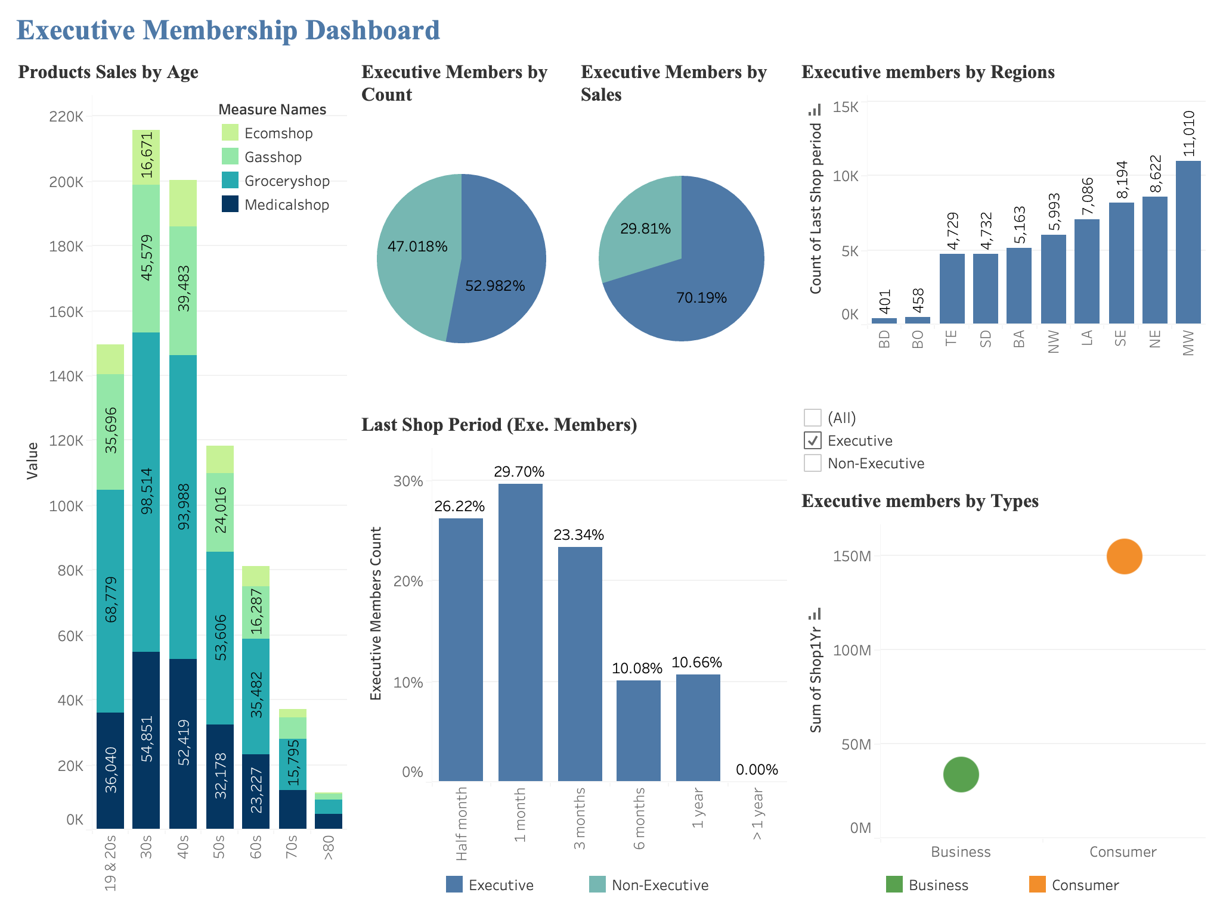
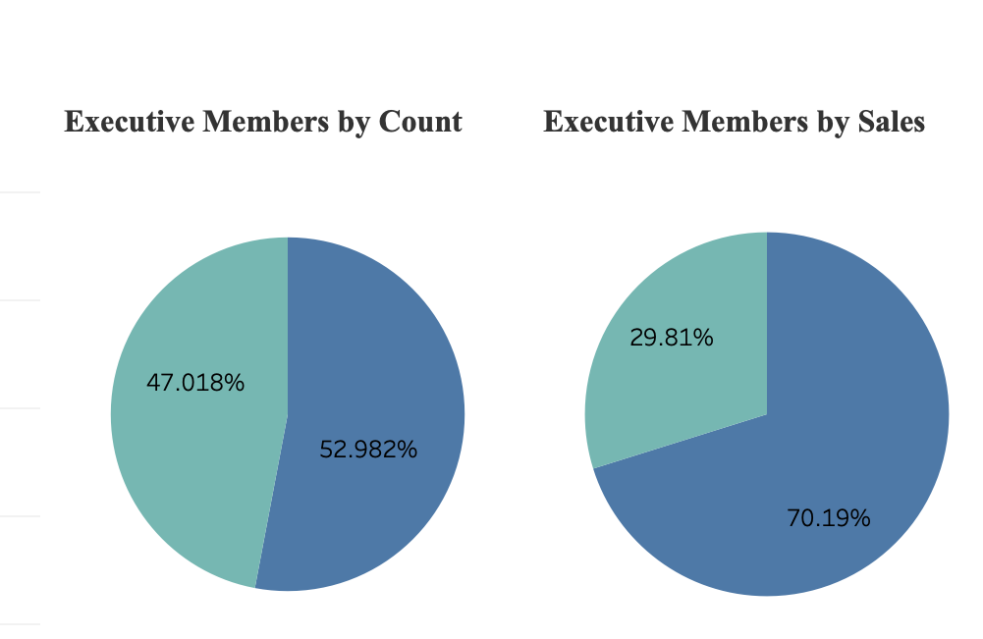
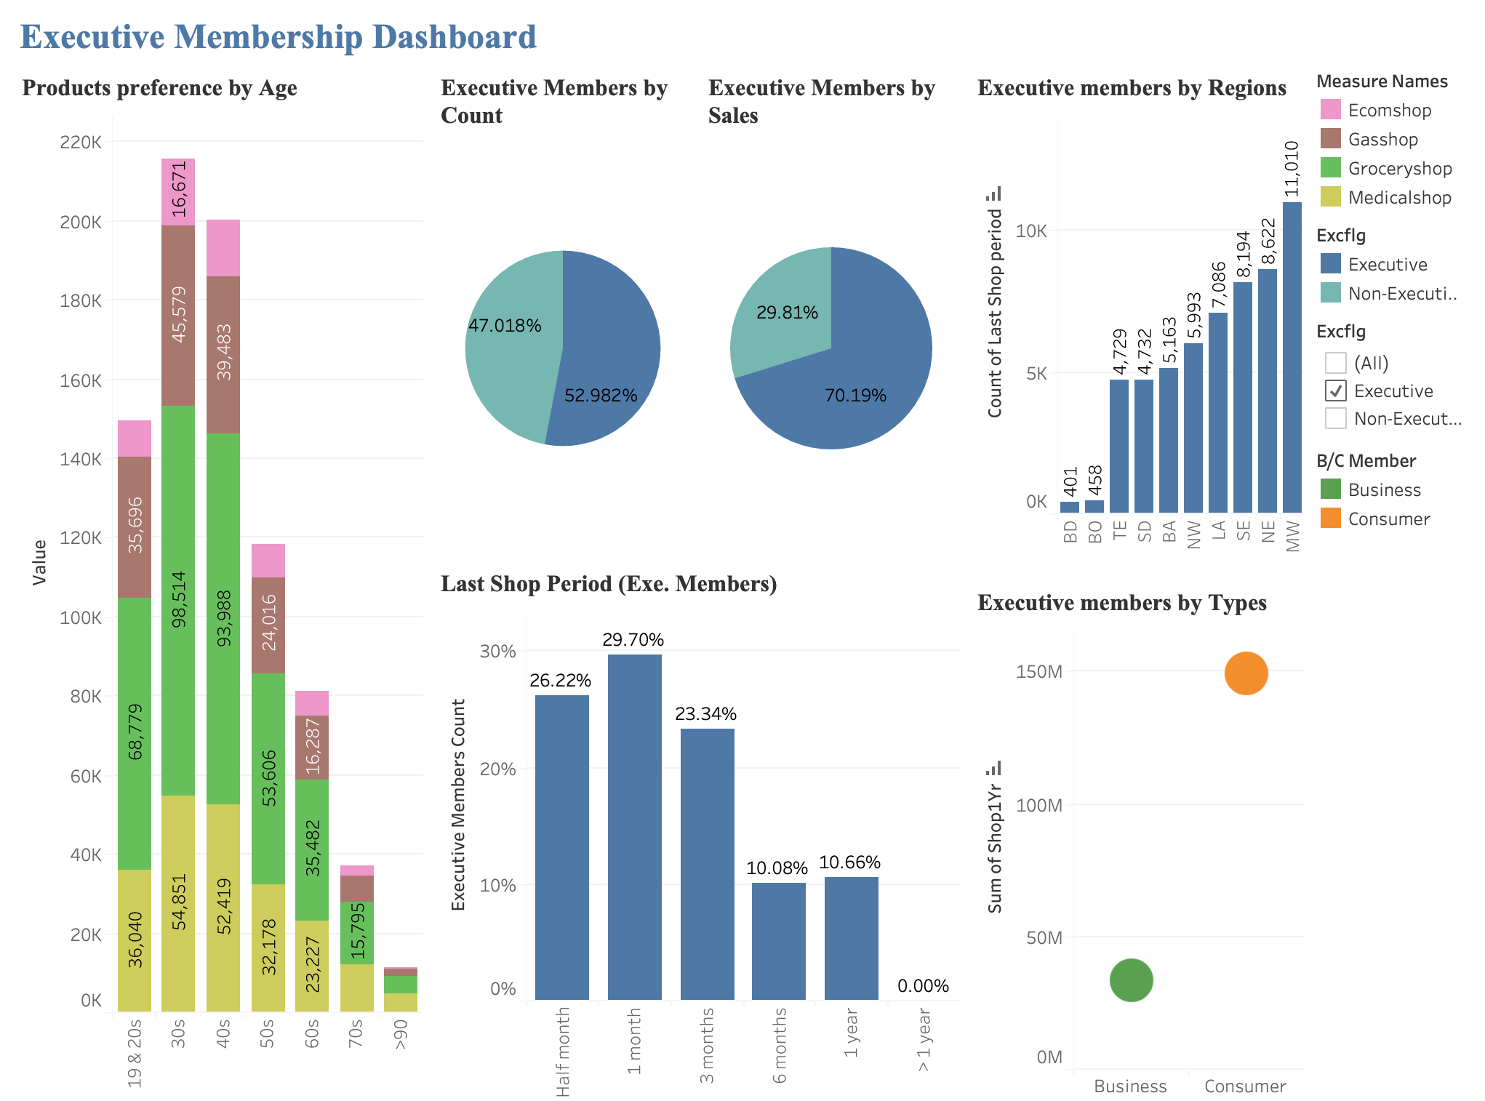
Membership team
Notes:
In Membership segment, assumption that Executive is paid accounts, with perks for customers
1. Products preference by Age: age group by 10 years since I recognize that the buying habit might have significant change in every 10 years. As we can see here Grocerry takes up a major part in all age group. On another note, the 30 and 40s age group are the highest spending in all group, quite obviously right skewed in the spending by age
2. When putting the membership on pie chart, it’s interesting to find that Executive customers take up around half of the total buying customers, but they accumulate more than 70% of our revenue
These 2 piechart telling us how important the Executive Members are to our business and we should have campaign to acquire more Executive members
3. 20% Exe. Customers have not purchased in the last 6 months or more. Considering how import Exe.members are to our revenue stream, and the cost to acquire new customers is higher than retain current customer, we should put in efforts in re-engage these customers to re-purchase as soon as possible
3. However, we take a look into

Slide 14
Membership team

Slide 15
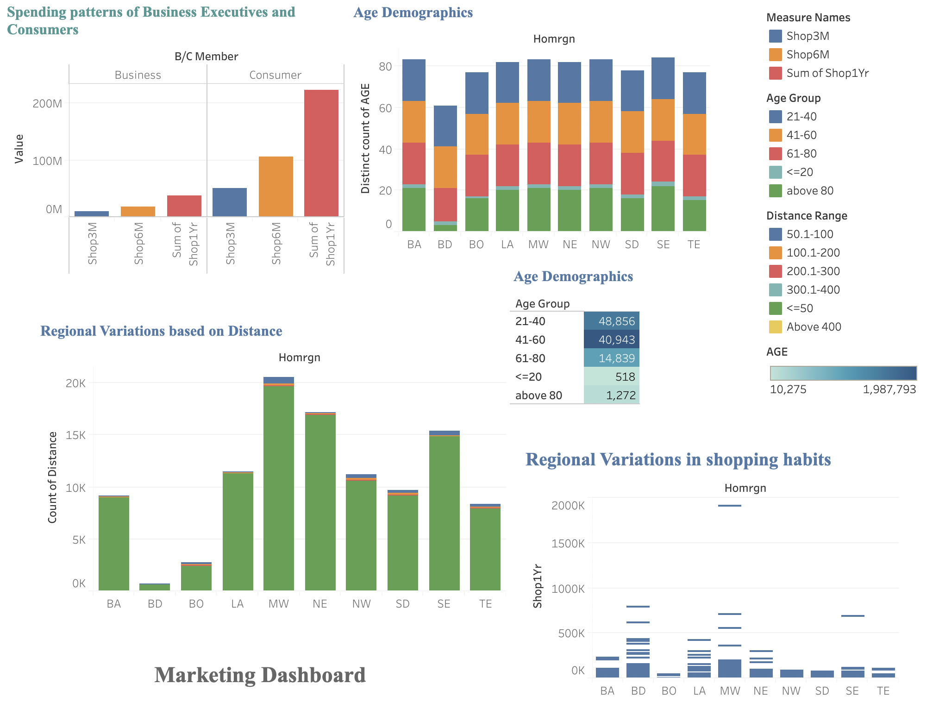
Marketing team
Notes:
Spending preferences of Executive and Non-Executive Members:
The data shows a significant difference in shopping expenditures between non-executive and executive members over the past year, six months, and three months. This consistent pattern suggests a trend rather than a one-time occurrence.
The total shopping expenditure of non-executive members for the past year was 223,836,844 units of currency, while executive members only spent 36,871,454 units. This substantial difference indicates that non-executive members are more active shoppers within the given time frame.
The data suggests that non-executive members may have more leisure time or flexibility to engage in shopping activities compared to executives. This could be attributed to the distinct roles and responsibilities within the organization, with executives being more focused on managerial duties and having less time for personal shopping.
The trend of non-executive members outspending executives continues in both the medium and short-term. Over the past six months, non-executive members spent 106,801,764 units compared to the 18,722,577 units spent by executives. In the most recent three months, non-executive members spent 50,828,654 units, while executives spent 9,052,126 units. This indicates a persistent difference in shopping behaviors between the two groups.
The contrasting spending patterns between non-executive and executive members may reflect differences in income levels, job responsibilities, and lifestyle choices. Non-executive members, potentially having lower salaries compared to executives, may prioritize personal items and experiences. On the other hand, executives may allocate their financial resources towards investment opportunities, business-related expenses, or other financial commitments.
Regional variations in shopping habits:
With the 'MW' region consistently showing the highest sales figures over the 3-month and 6-month periods.
This indicates a strong consumer base and a higher inclination for shopping in that region. Retailers can capitalize on this information by concentrating their marketing efforts on the 'MW' region, allocating resources, and implementing targeted strategies to meet the existing demand. This may involve personalized advertising, exclusive promotions, or improved customer service to retain and expand market share.
On the other hand, the 'BO' region consistently exhibits the lowest sales figures.
This presents an opportunity for retailers to analyze the reasons behind the underperformance. Factors such as limited awareness, unfavorable market conditions, or insufficient product availability may contribute to the low sales volume. Armed with this knowledge, retailers can tailor their marketing strategies to address these specific challenges. This may include conducting market research, increasing brand visibility, or adapting product offerings to better align with the preferences and needs of the 'BO' region.

Slide 16
Marketing team
- Recognized for …
Notes:
2 questions each dept -> avoid duplication

Slide 17
CONCLUSIONS & Recommendations
Executive members
Store development
Marketing
department
Customers have higher shopping expenditure compared to Business Executives.
Maximum customer base ranges from 21-40 years.
Recommend:
Leverage regional variations in shopping habits
Segment marketing campaigns based on age groups
Customize strategies for different customer tenure stages
Executive members take up 52% of total customers but accounts for 70%+ of sales revenue
20% Executive customers had not purchased for 6 months or more
Recommend:
Create initiates to increase Executive members
Create initiates to pursue Executive. customers for re-purchase
MW outperforms the NE though with comparatively fewer warehouses.
BO (only one warehouse) has strong engagement and visits.
Customers within close proximity to store shop online frequently.
Recommend:
Optimize MW region to capitalize the high shopping frequency
More online sales initiates for >100mile radius customers
Warehouse expansion to distant regions as well as BO
Notes:
Leverage regional variations in shopping habits: Recognize the regional differences in shopping behaviors and adjust marketing strategies accordingly. Allocate resources to focus on regions with higher sales figures, such as the 'MW' region, by implementing personalized advertising, exclusive promotions, and enhanced customer service. Conduct market research and adapt product offerings to address the specific challenges and preferences of regions with lower sales figures, like the 'BO' region. By tailoring marketing efforts to regional variations, the marketing team can optimize sales and market penetration.
Segment marketing campaigns based on age groups: Utilize the age group information to create targeted marketing campaigns. Develop strategies that align with the lifestyle choices, interests, and spending power of different age groups. For example, for the 21-40 age range, focus on technology, fashion, travel, and experiences. For the 41-60 age range, emphasize quality, value for money, and products related to home improvement, luxury goods, healthcare, and travel. Adapt marketing approaches for older age groups, such as retirement planning, senior discounts, and healthcare solutions. By tailoring campaigns to specific age groups, the marketing team can effectively reach and engage their target audience.
Customize strategies for different customer tenure stages: Customize marketing strategies based on customer tenure to enhance customer acquisition, retention, and loyalty. For new customers (0-0.3 years tenure), develop targeted onboarding campaigns to provide a seamless and personalized experience, with the goal of increasing initial spending and fostering long-term loyalty. For customers in the 0.9-1.3 years tenure range, implement customer retention initiatives to counter any decrease in spending, such as personalized communication, loyalty programs, and tailored promotions. By recognizing and addressing the specific needs and behaviors of customers at different tenure stages, the marketing team can drive customer satisfaction, repeat purchases, and customer lifetime value.

Slide 18
References
Yuval Noah Harari Youtube Channel. Retrieved from https://www.youtube.com/@YuvalNoahHarari
Tableau Community Updates. Retrieved from https://community.tableau.com/s/community-updates
Intact Abode Youtube Channel (Mar 17, 2019). How to Show Percentage Label in Pie Chart Tableau Desktop. Retrieved from https://www.youtube.com/watch?v=SKbUejuzDbM
Harari N. (August 10th). Coursera Blog. Retrieved from https://blog.coursera.org/history-began-when-humans-invented-gods-and-will/#:~:text=With%20the%20help%20of%20novel,end%20when%20humans%20become%20gods.
Andy Kriebel. (2022, February 22). How to Tableau : Multiple Measures on Multiple Rows [Video]. YouTube. https://www.youtube.com/watch?v=6o_D9vDZfa8
Chapman, C. (2018). Exploring the Gestalt Principles of Design. Toptal Design Blog. https://www.toptal.com/designers/ui/gestalt-principles-of-design#:~:text=What%20are%20the%20gestalt%20principles,been%20added%20in%20recent%20years.
Johnson, H. (2021, September 9). Making the switch from Excel to Tableau - From Excel to Tableau [Video]. LinkedIn. https://www.linkedin.com/learning/from-excel-to-tableau/making-the-switch-from-excel-to-tableau?u=74653650

Slide 19

A picture is worth a thousand words

